Slide 1
ComplyDesk
AI-Assisted SME Onboarding & AML Compliance Copilot
From manual KYC checks and rules-only alerts → an explainable, auditable,
AI-assisted compliance workflow with a human officer approving every decision.
Aligned to MAS FEAT responsible-AI principles · runs on synthetic AML data
NUS-ISS GDipSA · AD Project — Proposal Presentation | Team __ · Members: ____

Slide 2
Project Description & Stakeholder Value
The problem
Value to stakeholders
Digital banks onboarding SMEs face manual KYC document checks and rules-only transaction alerts that flood analysts with false positives; suspicious-transaction reports are written by hand — slow, inconsistent, hard to audit.
Compliance analyst
Agent drafts narrative + recommendation → less manual write-up, faster case clearance
MLRO / approver
Explainable risk scores + full audit trail → confident, defensible sign-off (on mobile)
The solution
One platform where an ML model scores transaction risk (with explanations), an AI agent gathers context and drafts the case narrative & recommended action, and a human compliance officer approves, edits or rejects every decision — end to end, on one backend, deployed to the cloud.
SME customer
Faster, transparent digital onboarding with live status tracking
Bank / regulator
Fewer false positives, consistent decisions, MAS-aligned auditability
Integrated technologies: Mobile (React Native) · Web (React) · ML (Python/XGBoost/SHAP) · Agentic AI (LangGraph + human-in-the-loop) · Dashboard (Chart.js) · common backend (Spring Boot/PostgreSQL) · cloud + CI/CD (AWS, GitHub Actions)

Slide 3
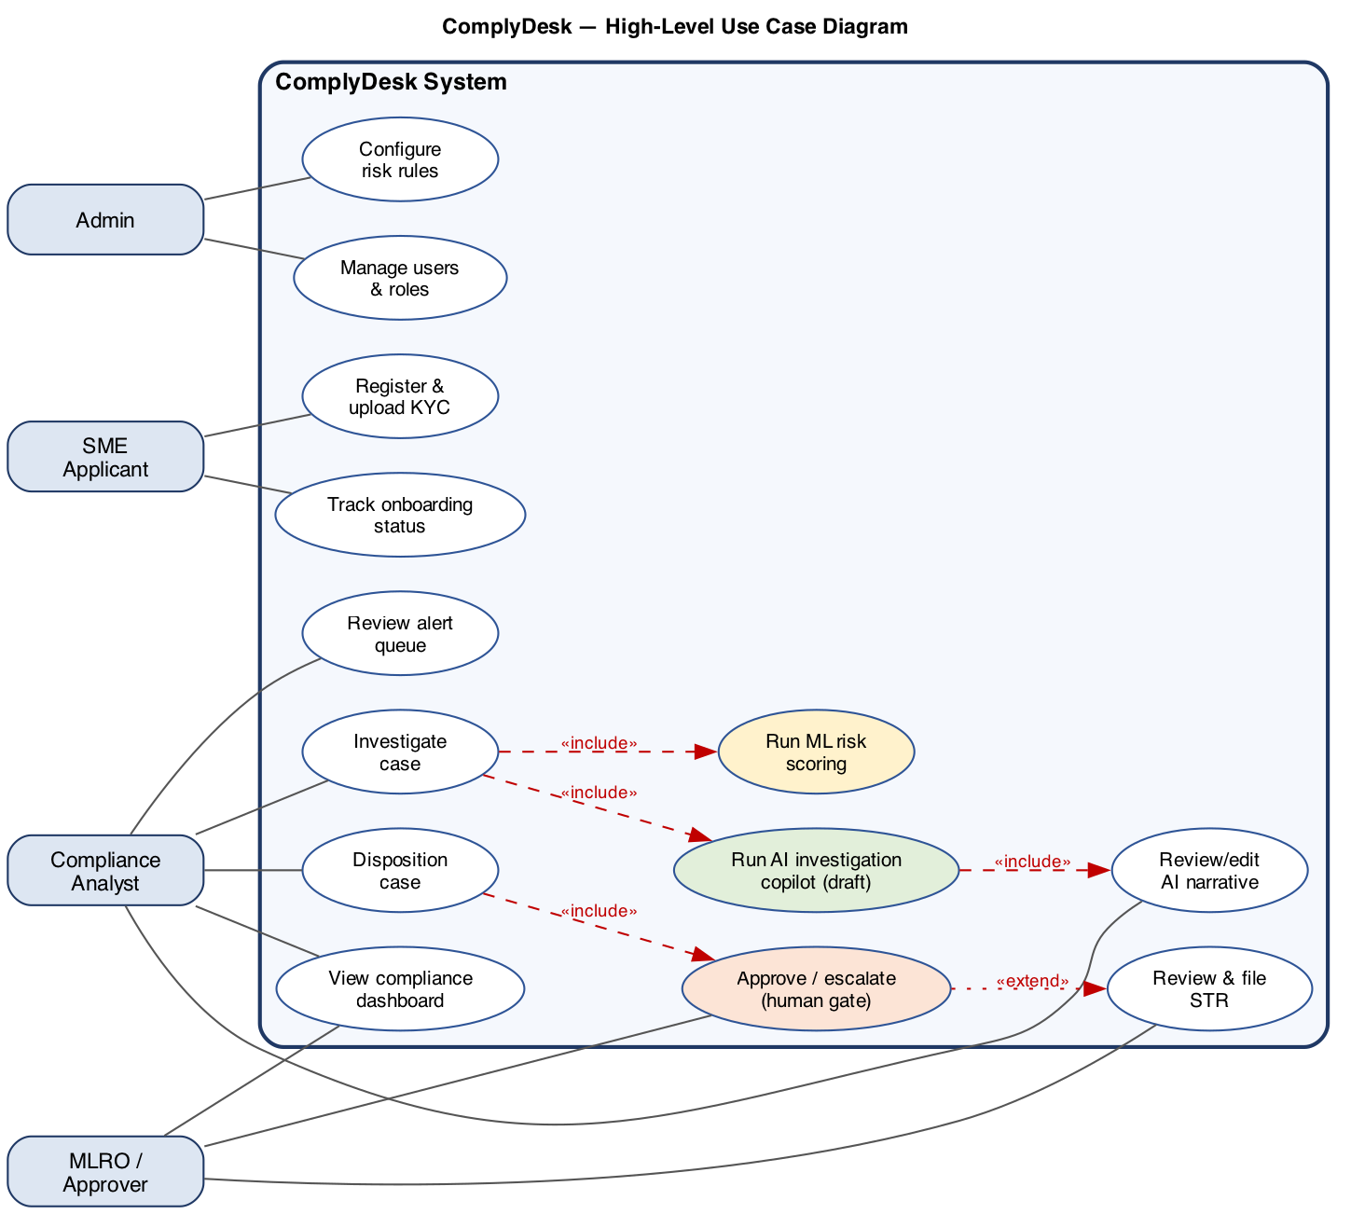
Use Case Diagram & Product Backlog
Product backlog — 71 features / 11 epics
Prioritised MoSCoW → value → effort: 34 Must · 28 Should · 9 Could
Epic
Key technologies
Onboarding & KYC
React Native, S3, OCR
Case & alert mgmt
React, Spring Boot
Monitoring & ML risk
XGBoost, FastAPI, SHAP
Agentic AI copilot
LangGraph, LLM, HITL
STR reporting
Spring Boot, PDF
Analytics dashboard
React, Chart.js
MLRO mobile approvals
React Native, push
Auth / audit / admin
Spring Security, PostgreSQL
DevSecOps & cloud
AWS, GitHub Actions, Semgrep
MVP = all 34 Must items (4-week scope). Full prioritised backlog in the accompanying Excel. Prototype screens (Figma) optional.
Actors, system boundary, and the human-approval gate; «include» pulls in ML scoring + AI copilot.

Slide 4
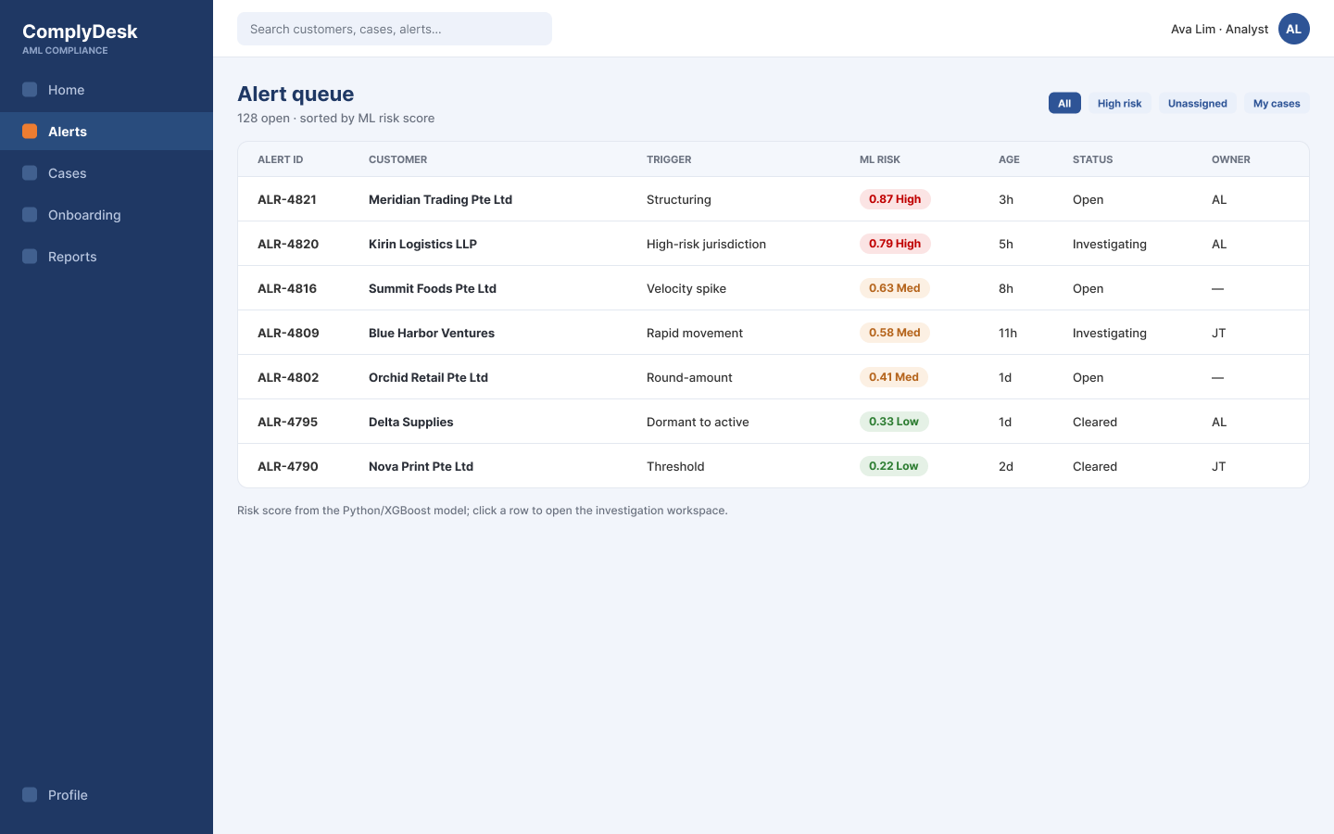
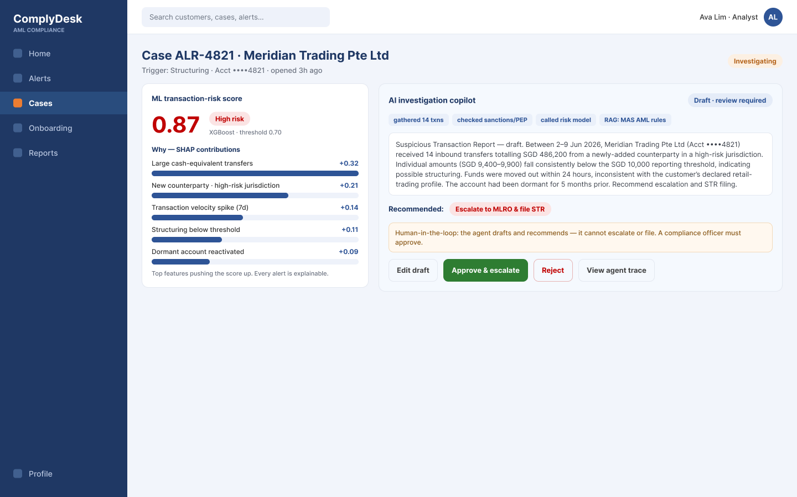
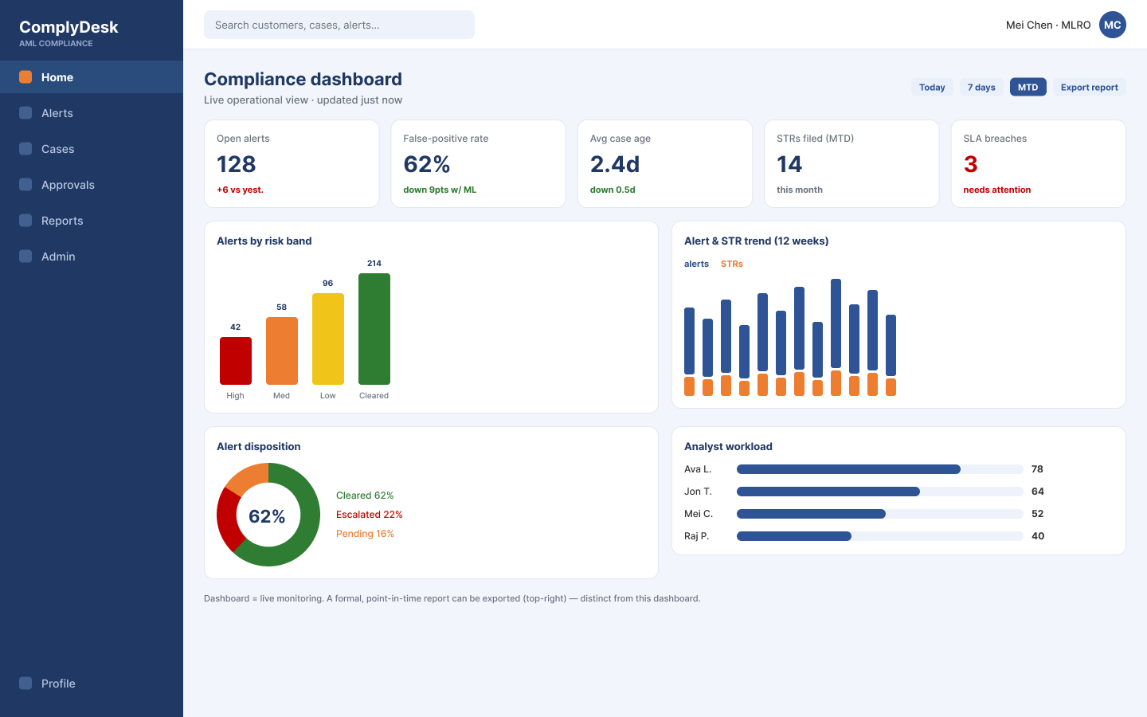
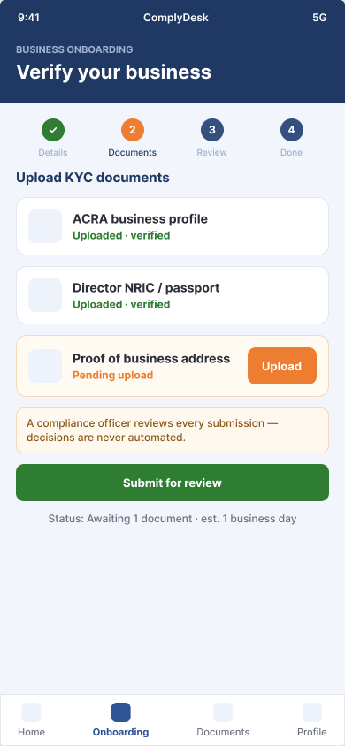
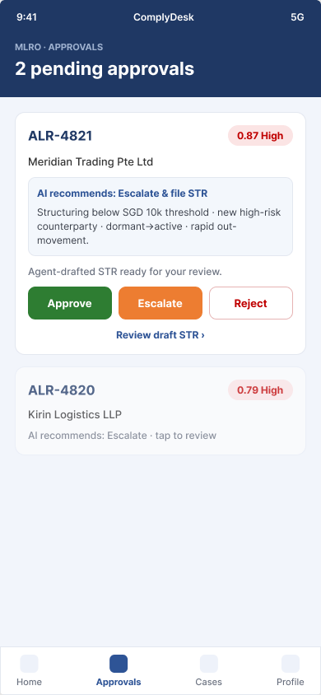
Prototype Screens — two apps, role-accurate
Customer app (SME) + staff console (analyst / MLRO) · built in Figma · nav differs by role (segregation of duties)
② Alert queue — Analyst (web)
③ Investigation workspace — Analyst (web)
⑤ Compliance dashboard — MLRO (web)
Why the navigation differs by role
• Two products: ComplyDesk for Business (external SME app) and ComplyDesk Console (internal staff, web + mobile).
• The SME app never exposes internal alerts or cases — data segregation.
• Only the MLRO sees Approvals & Admin; analysts do not — segregation of duties (an AML / MAS-FEAT control).
• Home & Profile are shared across all apps for one design language.
Hero flow: report → ML risk score (+SHAP) → AI copilot drafts STR → human approves → dashboard updates.
① SME onboarding — Customer (mobile)
④ MLRO approvals — MLRO (mobile)

